Slide 1
Lecture 10
Topics
Application of DFS
  Topological Sort
  Strongly Connected Components
Reference: Introduction to Algorithm by Cormen
Chapter 23: Elementary Graph Algorithms
Data Structure and Algorithm

Slide 2
Directed Acyclic Graph
A directed acyclic graph or DAG is a directed graph with no directed cycles:
Data Structure and Algorithm

Slide 3
DFS and DAG
Theorem: a directed graph G is acyclic if and only if a DFS of G yields no back edges:
  => if G is acyclic, will be no back edges
    Trivial: a back edge implies a cycle
  <= if no back edges, G is acyclic
    Proof by contradiction: G has a cycle ⇒ ∃ a back edge
      Let v be the vertex on the cycle first discovered, and u be the predecessor of v on the cycle
      When v discovered, whole cycle is white
      Must visit everything reachable from v before returning from DFS-Visit()
      So path from u (gray)→v (gray), thus (u, v) is a back edge
v
u
Data Structure and Algorithm

Slide 4
Topological Sort
Topological sort of a DAG:
  Linear ordering of all vertices in graph G such that vertex u comes before vertex v if edge (u, v) ∈ G
Real-world application:
  Scheduling a dependent graph,
  Find a feasible course plan for university studies
Data Structure and Algorithm

Slide 5
Example
Undershorts
Socks
Watch
Pant
Shoes
Shirt
Belt
Tie
Jacket
Data Structure and Algorithm

Slide 6
Example (Cont.)
Undershorts
Socks
Watch
Pant
Shoes
Shirt
Belt
Tie
Jacket
Socks
Undershorts
Pant
Shoes
watch
Shirt
Belt
Tie
Jacket
Data Structure and Algorithm

Slide 7
Algorithm
Undershorts
11/16
Socks
17/18
Watch
12/15
Pant
Shoes
13/14
9/10
Shirt
1/8
6/7
Belt
Tie
2/5
Jacket
3/4
Socks
Undershorts
Pant
Shoes
watch
Shirt
Belt
Tie
Jacket
17/18
11/16
12/15
13/14
9/10
1/8
6/7
2/5
3/4
Data Structure and Algorithm

Slide 8
Algorithm
Topological-Sort()
{
  Call DFS to compute finish time f[v] for each vertex
  As each vertex is finished, insert it onto the front of a linked list
  Return the linked list of vertices
}
Time: O(V+E)
Data Structure and Algorithm

Slide 9
Correctness
Prove if edge from u to v then f[u] > f[v]
Data Structure and Algorithm

Slide 10
Correctness
Prove if edge from u to v then f[u] > f[v]
When u is grey, v can be –white –black –grey
- white: then f[u] > f[v]
- black: then f[u] > f[v]
- grey: this cannot happen since v being grey when u is exploring indicates v is ancestor of u which along with edge (u,v) will form a cycle!
Data Structure and Algorithm

Slide 11
Correctness
Prove if a path from u to v then f[u] > f[v]
When u is grey, v can be –white –black –grey
- white: then f[u] > f[v]
- black: then f[u] > f[v]
- grey: this cannot happen since v being grey when u is exploring indicates v is ancestor of u which along with path (u,v) will form a cycle!
Data Structure and Algorithm

Slide 12
Why not use sorted starting times ?
What if there were cycles in the graph! How would you check to make sure you are not giving a topological sort for a cyclic graph
Data Structure and Algorithm

Slide 13
Why not use sorted starting times ?
Counterexample!
Consider a triangle A 1/6 B 4/5
C 2/3
--if back edge present while doing DFS then cycle in graph so stop and report as no topological sort possible.
Data Structure and Algorithm

Slide 14
Kahn’s algorithms
Consider repeatedly outputting and deleting nodes whose indegree is 0. (BFS based sorting)
Will this work? What is the complexity?
Data Structure and Algorithm

Slide 15
You maintain an AdjList along with the current indegree of each node.
Keep a queue which is the set of nodes with indegree 0.
Each time you pick a node whose indegree is 0, dequeue it, reduce indegree of all nodes adjancent to it. While reducing the indegree if any node indegree turns 0 add it to the queue.
What happens if there are cycles?
https://courses.cs.washington.edu/courses/cse326/03wi/lectures/RaoLect20.pdf
Data Structure and Algorithm

Slide 16
Strongly Connected Components
Every pair of vertices are reachable from each other
Graph G is strongly connected if, for every u and v in V, there is some path from u to v and some path from v to u.
Strongly Connected
Not Strongly Connected
Data Structure and Algorithm

Slide 17
Example
a
{ a , c , g }
g
c
d
{ f , d , e , b }
e
f
b
Data Structure and Algorithm

Slide 18
Finding Strongly Connected Components
Input: A directed graph G = (V,E)
Output: a partition of V into disjoint sets so that each set defines a strongly connected component of G
Data Structure and Algorithm

Slide 19
Algorithm
Strongly-Connected-Components(G)
call DFS(G) to compute finishing times f[u] for each vertex u. Cost: O(E+V)
compute G^{T} Cost: O(E+V)
call DFS(G^{T}), but in the main loop of DFS, consider the vertices in order of decreasing f[u] Cost: O(E+V)
output the vertices of each tree in the depth-first forest of step 3 as a separate strongly connected component.
The graph G^{T} is the transpose of G, which is visualized by
reversing the arrows on the digraph.
Cost: O(E+V)
Data Structure and Algorithm

Slide 20
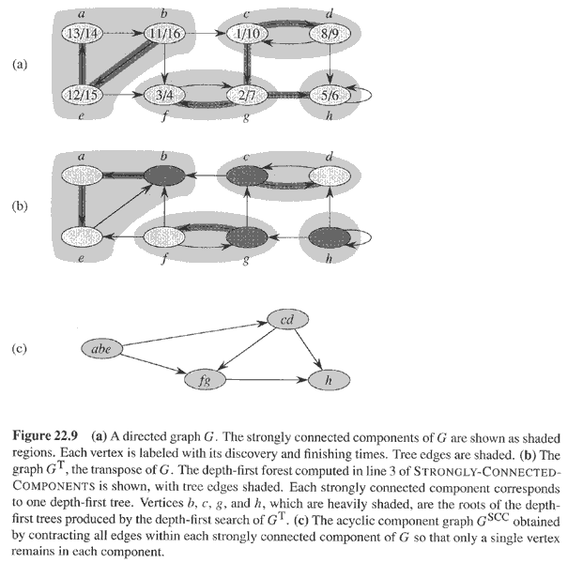
Example
Data Structure and Algorithm

Slide 21
Questions
Let C={C₁,C₂....,C_{n} } be the set of strongly connected components of G=(V,E).
Let,
G^{SCC} =(V^{SCC}, E^{SCC}) where V^{SCC}={v₁,v₂,....v_{n}} where each vertex v_{i} in V^{SCC} represents the strongly connected component C_{i} in C. There is a directed edge (v_{i}, v_{k}) in E^{SCC} if there is a directed edge (x,y) ∈ E such that x ∈ C_{i} and y ∈ C_{k}.
Then, ((G^{T})^{SCC})^{T} = G^{SCC} where G^{T} denotes the transpose graph of G.
True/False ?
Data Structure and Algorithm

Slide 22
Consider a directed graph G=(V,E) where each node is initially colored white. What should be the minimum number of nodes that we should change to red such that for each white node v in G, there exists at least one red node r such that there is a directed path from r to v and v to r. Assume that for every node there is at least one other node it is reachable from and can reach to.
Data Structure and Algorithm

